Slide 1
Presenter notes
Resources:
Docs: Setting up an Enterprise account
GitHub Partner program
GitHub Enterprise Server releases
GitHub pricing
GitHub public roadmap
Demo prep:
Show GitHub roadmap (Optional)
FAQ:
On final slide, in notes
Customer stories:
None
Expected timing:
10-15 minutes

Slide 2
GitHub offerings
GitHub Bootcamp
@presenter name (optional)
Notes:
Let’s review the GitHub offerings from a product perspective.
This is important because one of the hardest things for new GitHub partners to understand is which parts of GitHub are offered in which product SKU.
It is important for you to have this knowledge as you interact with customers. For example, when discussing Advanced Security, you’ll want to understand which product the customer has and which ones they will need.
Quick run-through of all the products.

Slide 3
This module will enable you to:
Advise customers on GitHub topics in the context of the features available to them in their current GitHub SKU
Differentiate features available on various GitHub SKUs when working with customers

Slide 4
GitHub Cloud
Great for new teams just getting started with GitHub. Teams on this plan graduate to the GitHub Enterprise Cloud plan when their needs grow
Very few customers use this option
Fast and straightforward deployment, up in minutes
Lightweight pricing to make it approachable for new companies
Notes:
This slide assures that the audience is aware of the offering that they may have initially been introduced to. This offering will not offer the level of security that a larger enterprise will require. Small teams, non-profits, or startups may begin with this level.
First and foremost, GitHub Cloud is what most of you are familiar with from using GitHub.com.
This is the easiest environment for a customer to use, create an org, sign up users, etc.

Slide 5
GitHub Enterprise Cloud
Effortless infrastructure, the power of the community, and all the integrations you know and love
Fast and straightforward deployment, up in minutes
Setup is usually focused on SSO integration and permission config
Enterprise accounts can enable easier management of multiple business organizations
Notes:
Participants who are interested in a more advanced level of security, do not require on-prem installations, and have multiple organizations will be attracted to Enterprise Cloud
That’s the simple side, there are other things like SAML and AAD (Azure Active Directory) so you can use the same authentication.
With Cloud, GitHub hosts it for you, everything is managed for you, so what you’re really administering is your policies, your users, and how you use the product. You don’t have to manage the deployment.
********
Resources
https://help.github.com/en/github/setting-up-and-managing-your-enterprise-account/about-enterprise-accounts
********

Slide 6
GitHub Enterprise Server
GitHub Enterprise Server enables customers to manage their infrastructure and isolate their data
More involved setup, but an easy deployment and can be running in minutes
Same code base as GitHub Enterprise Cloud, but features usually land a few months after GHEC
More optimization of the environment to fit the needs of your organization
Notes:
This offering moves away from the cloud and offers an on-prem version of GitHub Enterprise. This product version also gives the customer direct control over system optimization.
Important note: Feature updates are often on a delivery schedule behind GHEC.
GHES - for those of you who know ADO, there’s server vs cloud, and it’s the same on the GH side.
It’s an appliance that you run on your own hardware or within cloud provider hardware. It is more involved, you have to maintain, manage, set it up, but once it’s set up and running, the user experience is going to be almost identical, with the main exceptions being the URL from which users would access it and “public” repositories on Server means something different than “public” on Cloud. We’ll get into that in more detail tomorrow.
GitHub Connect: there is an option to connect GitHub Enterprise Cloud and GitHub Enterprise Server so contributions and unified search are available on GitHub Enterprise Server

Slide 7
GitHub One
GitHub One: all of GitHub’s enterprise capabilities in a single product.
Advanced Security
GitHub Insights
24/7 Premium Plus support
Learning Lab for organizations
Notes:
This slide points out the things that make GitHub One different from GitHub Enterprise Server. GitHub One is a SKU that has been in development and is planned for broader adoption, but we aren’t necessarily there yet. GitHub One is different than other SKUs because it includes a-la-carte products by definition. If this product is out of the scope of your potential customers, you may choose to skip or go very quickly over this slide until GitHub One is more prominent.
With GH One, in addition to GHE, you get access to the features and products listed here.
When you now get GHE, you buy a license, you get a license to both GHEC and GHES. It really comes down to a customer use case whether they choose server, cloud, or both. One is on top of that where you get access to more security, insights, support, and training.
********************
Note to presenter:
Please consult your account manager to obtain details on any associated costs.
********************

Slide 8
GitHub AE
Private, GitHub managed offering for companies that need high levels of security, privacy, and control in a SaaS-like environment.
Enables provisioning of thousands of users at once
More control of accounts for audits and access for enterprises
Meets government cloud requirements
Notes:
Technical Notes
It is GHES but where we, as GitHub, manage all of the environment for you. You don’t actually have to manage the maintenance, upkeep, care and feeding of it. (Infrastructure as a service)
The most secure and compliant DevOps SaaS offering - GitHub “AE”.
Data sovereignty
Isolated infra (single tenancy)
Provides levels of security compliance to meet the needs of a specific subset of industries and government
Question to anticipate: What is the upgrade cycle for GitHub AE?
******
Additional context on GitHub AE:
Use of "GitHub AE" in print and speech:
In print:
Full Product Name: GitHub AE
Abbreviations (after first use of full name in print): GHAE
In speech:
GitHub AE is the preferred full spoken name.
We will refer to AE (hard vowel pronunciations of A - E) as the preferred abbreviated spoken version of the name.
Do not:
Refer to the product using ‘Aegis’ except in response to the questions about the meaning of the name.
Abbreviate to GHE AE or GHEAE ********

Slide 9
How do I get started?
To get started with GitHub’s Enterprise Cloud offerings:
Get a license through our Partner program
Download GitHub Enterprise (verify best download location)
Create an organization on GitHub
Notes:
We recommend figuring out the specifics for your partner organization and updating this slide accordingly. Include information about how your organization accesses these products.
As mentioned earlier, all of you being partners can get access to licenses to play around with these features and products.
Downloading: many customers get GitHub by searching for the recent AMI (Amazon Machine Image). Often when you sign up for a trial it shows the download link in those pages as well
********
Resources
https://partner.github.com
https://enterprise.github.com/releases
********

Slide 10
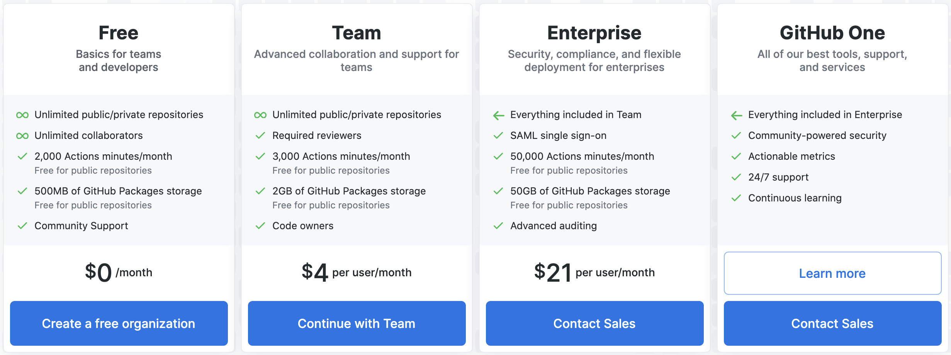
Sales view
Notes:
From a sales perspective, this is what you see.
**************************
Note to speaker:
This information comes from https://github.com/pricing. Check that this information is up to date, and relevant to your audience.
*************************

Slide 11
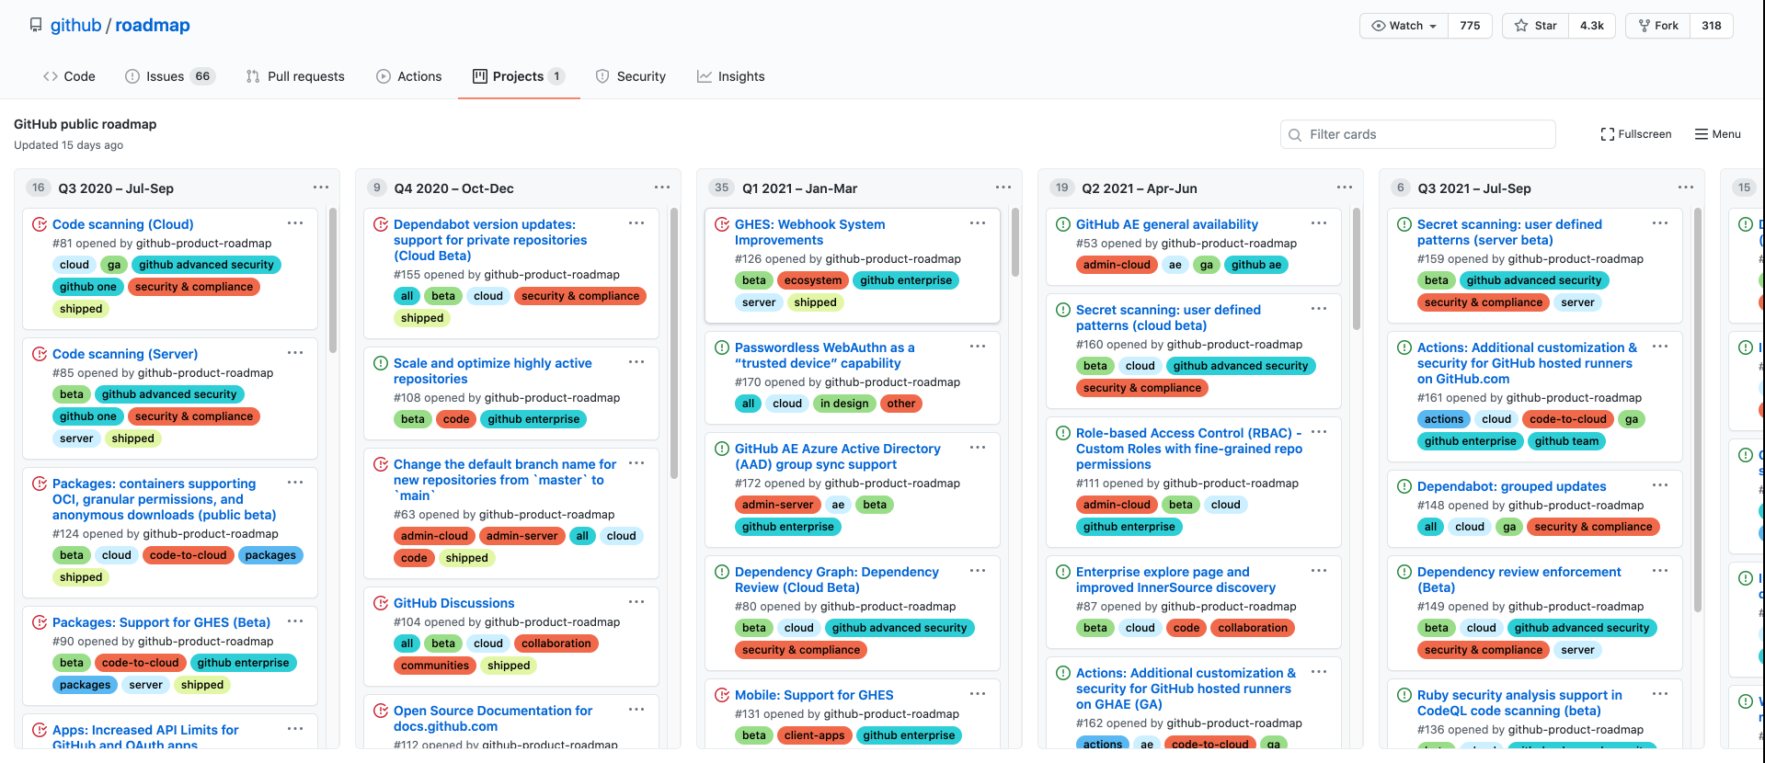
GitHub public roadmap
Notes:
This is GitHub’s public roadmap. Here, you can see exactly what we will be building next, which offerings it will apply to, and when it will be available.
********************
Roadmap source:
https://github.com/github/roadmap/projects/1
********************

Slide 12
Questions
Notes:
********************
Note to presenter:
The questions below are for your reference only. They are ones that you can anticipate receiving from the audience. However, there is no need to pose these to your audience.
********************
Q: What does AE stand for in GitHubAE?
A: AE stands for Aegis. Aegis implies protection and security - attributes that are totally core to the product. In the Greek language, Aegis means the protection, backing, or support of a particular person or organization. In Greek mythology aegis is an attribute of Zeus or Athena, usually represented as a shield.
Q: Will there always be a delay before new GitHub Cloud features reach Private Instance?
A: Historically, features have been passed along to GHPI after 1-2 quarters of being released on GitHub Cloud. GitHub is currently making efforts to reduce this amount of time.

